Slide 1
Chess Game
Group 9
Hany Ashraf Mohamed
Abdelrahman Gomaa Mohamed

Slide 2
Pre-Requirements
For any one who is not familiar with this game, he can visit http://www.chess.com/learn-how-to-play-chess

Slide 3
Introduction
Chess is a two-player strategy board
game played on a checkered board.
It can be played in many ways, one of these is to be played on program.

Slide 4
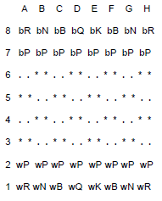
Our program will display the following board accept moves from the players(alternating between Black and White).

Slide 5
Program Features
Input: a move is specified by first giving the coordinates of the square containing the piece to move followed by the coordinates of the square to which the piece is to be moved. The coordinates of a square are given using a letter, specifying the column, and a number, specifying the row, “D7 D6”,for example.

Slide 6
Our program handling the exceptions (it is shown in execution below).
The program also generates an output file provides all the information about the game.
Also our program don’t pay attention to “check” and “checkmate”.

Slide 7
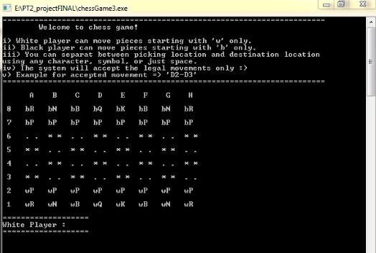
Program Sample Runs

Slide 8
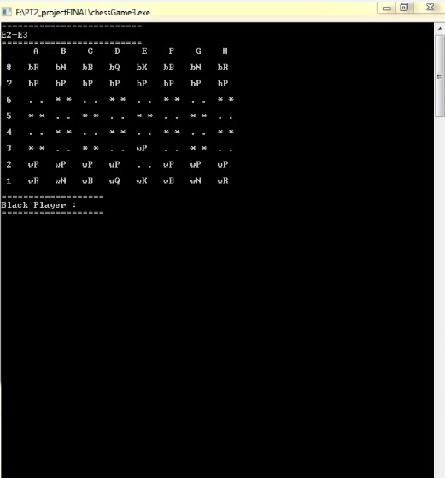

Slide 9
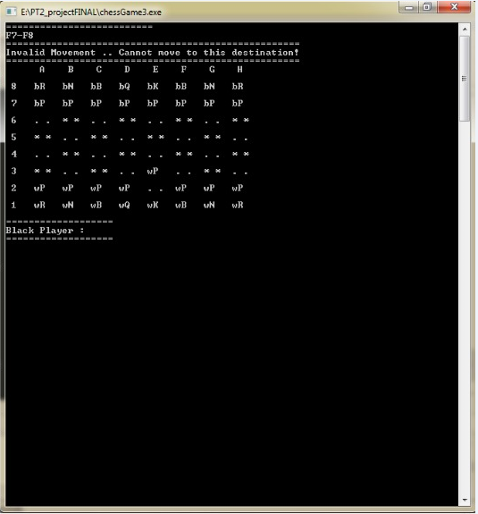
Example for some common exception handling in our system

Slide 10
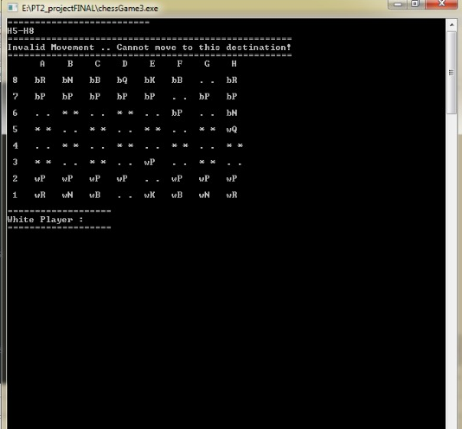

Slide 11
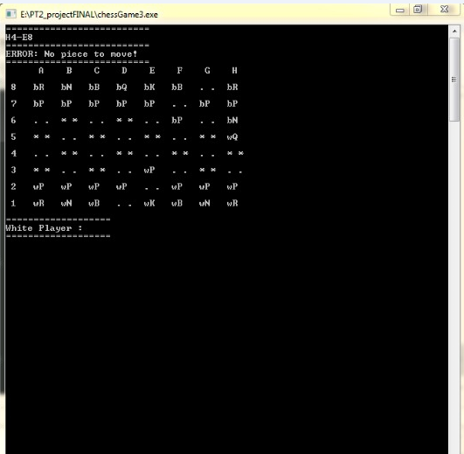

Slide 12
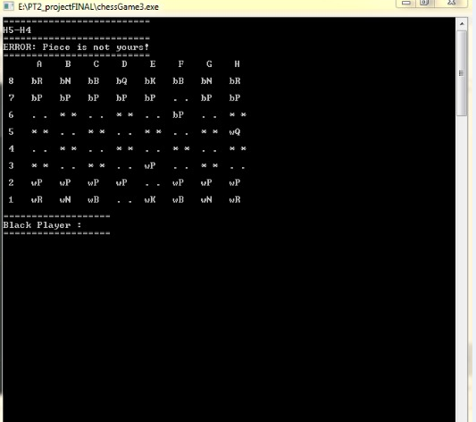

Slide 13
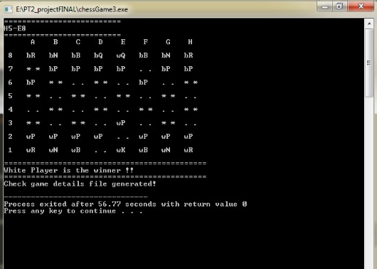

Slide 14
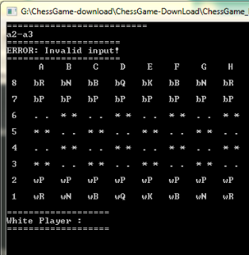
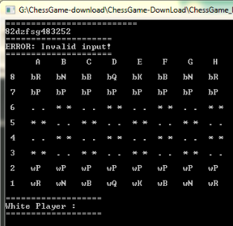
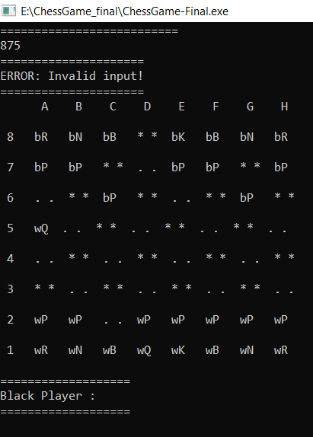
Example of handling invalid inputs

Slide 15
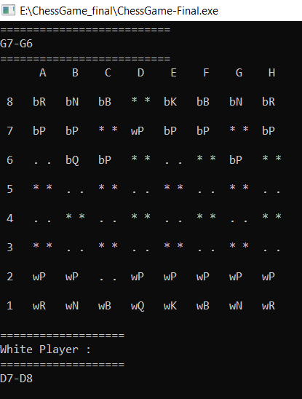
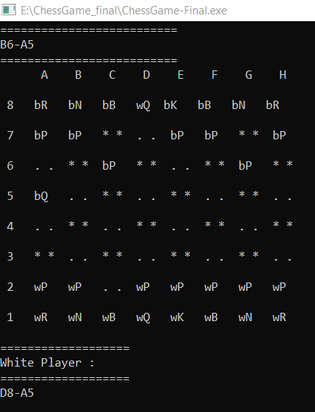
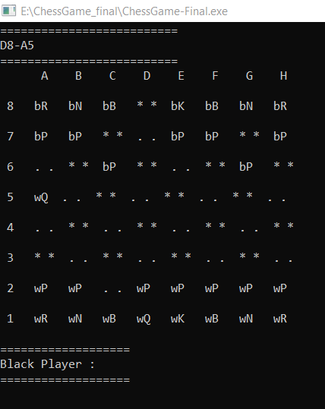
Pawn Promotion to queen

Slide 16
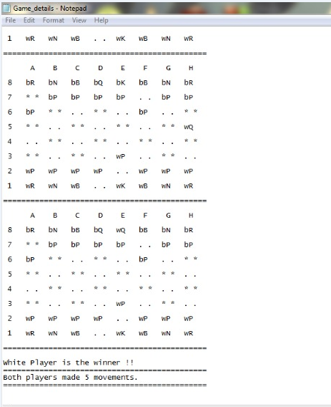
Part of the game details file generated at the end pf game

Slide 17
Thank You

